Slide 1
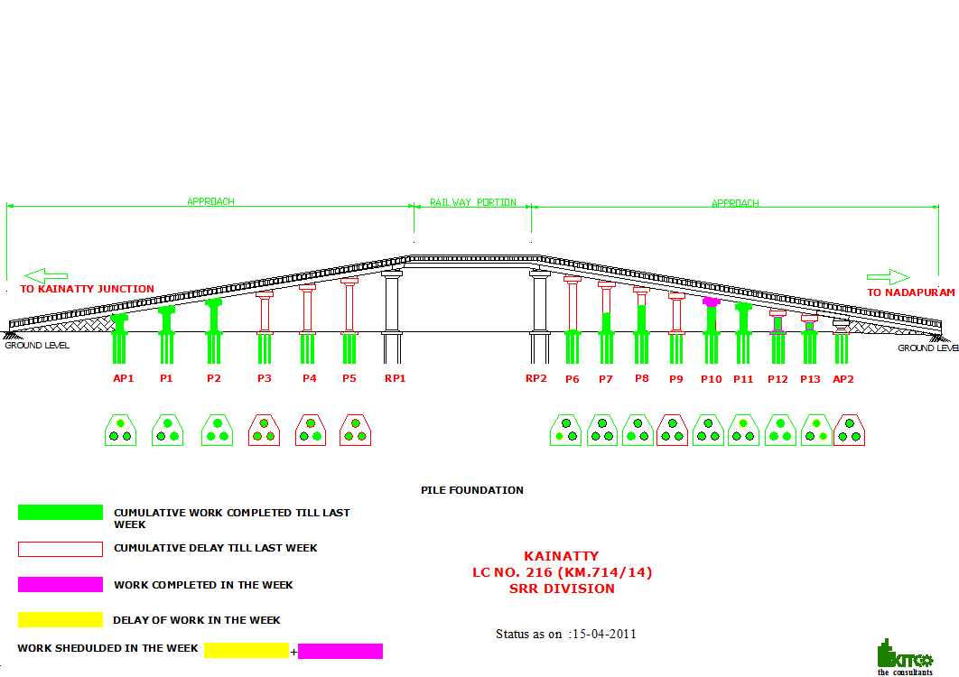
ROB at Kainatti Progress as on 15/04/11

